Slide 1



CAKE
http://cakebuild.net
patrik@patriksvensson.se
@firstdrafthell

Slide 2
Agenda
What is Cake?
The philosophy behind Cake
How does Cake work?
Dependency based programming
Demo!
Awkward silence followed by applause.

Slide 3
What is Cake? (1/5)
A build automation tool
Write your build scripts in C#
Runs on full .NET framework (net45) and .NET Core (netstandard1.6)
Powered by Roslyn and the Mono compiler
Not a replacement for your CI server!

Slide 4



What is Cake? (2/5)

Slide 5
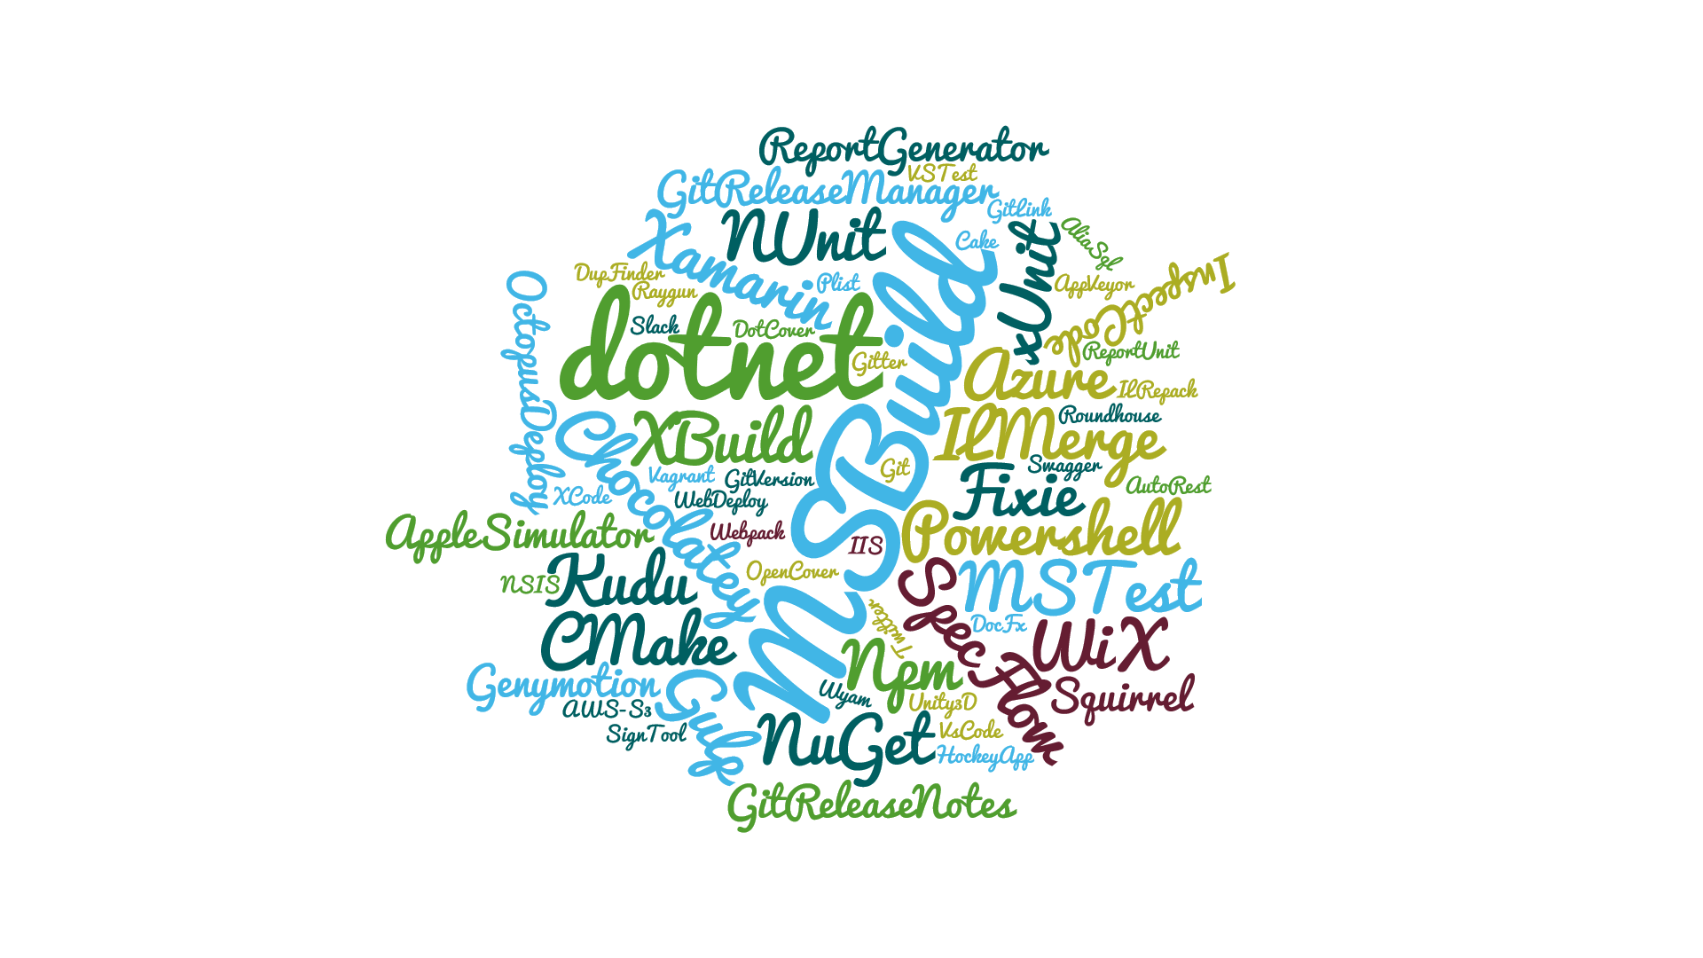
What is Cake? (3/5)

Slide 6


What is Cake? (4/5)
Open Source
Available on GitHub https://github.com/cake-build/cake
Part of the .NET Foundation
Project guidance and mentoring
IP & Legal
Financial support

Slide 7
What is Cake? (5/5)
A healthy community
694 pull requests
101 contributors
140+ third party addins and modules Azure, PowerShell, AWS, IIS, WebDeploy, Xamarin, Docker, Vagrant, Unity3D, SQL Server, CMake, Paket etc. etc.

Slide 8
Philosophy (1/3)
Increase team productivity
Decrease complexity of development and CI/CD
No binaries or sensitive information in repository
Build scripts and configuration in repository

Slide 9
Philosophy (2/3)
Non-intrusive
Doesn’t affect the way you or your team work
Behaves the same way
Regardless of operating system
Regardless of environment (i.e. TeamCity, AppVeyor, TFS, Jenkins, Bamboo, …)

Slide 10
Philosophy (3/3)
Convention based…
How tools and other things are resolved
…but also configurable
Provide your own configuration or override defaults
Implement your own tools
Replace internal parts you don’t like

Slide 11
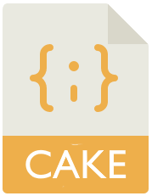






How does Cake work?
nupkg
exe
dll
msi
…
Input
Invoke target
Cake file (C#)
Some kind of result
In-memory assembly
Cake.exe
Input
Compile
Configuration and arguments
Install packages
Script engine
Packages

Slide 12
Dependency based programming (1/4)
Define your work as fine grained tasks
Clean
Unit tests
FxCop
Package
Build
Publish
Calculate version

Slide 13
Dependency based programming (2/4)
Order of execution is defined as dependencies between tasks.
Calculate version
Clean
Build
FxCop
Unit tests
Package
Publish

Slide 14

Dependency based programming (3/4)
Conditions influence whether a task should be skipped or not.
Calculate version
Clean
Build
FxCop
Unit tests
Package
Publish

Slide 15
Dependency based programming (4/4)
By executing a target, we determine what tasks should be executed.
Calculate version
Clean
Default
Build
FxCop
AppVeyor
Unit tests
Package
Publish

Slide 16
Demo a.k.a YDD

Slide 17
Calculate version
Clean
Default
Build
FxCop
AppVeyor
Unit tests
Package
Publish

Slide 18
Questions?

Slide 19
Thank you!
patrik@patriksvensson.se
@firstdrafthell

